Slide 1
AD CAMPAIGN PROJECT
CIS 3120 - Groups 8, 9, 10
Team Members
Cindy H, Samantha L, Patrick C, Iqra M, Shota M, Melisa K, Yasser K, Andrew Z,
Amin A, Mahfuzul H, Shameea M, Yeseo K, Karen G, Timothy Y, Jeongwon A

Slide 2
AGENDA
PRESENT
EXPLAIN
ANY BUGS?
IMPROVE
Cindy Huang
-MANIPULATING THE DATAFRAME
-SAVING THE DATA

Slide 3
P R E S E N T

Slide 4
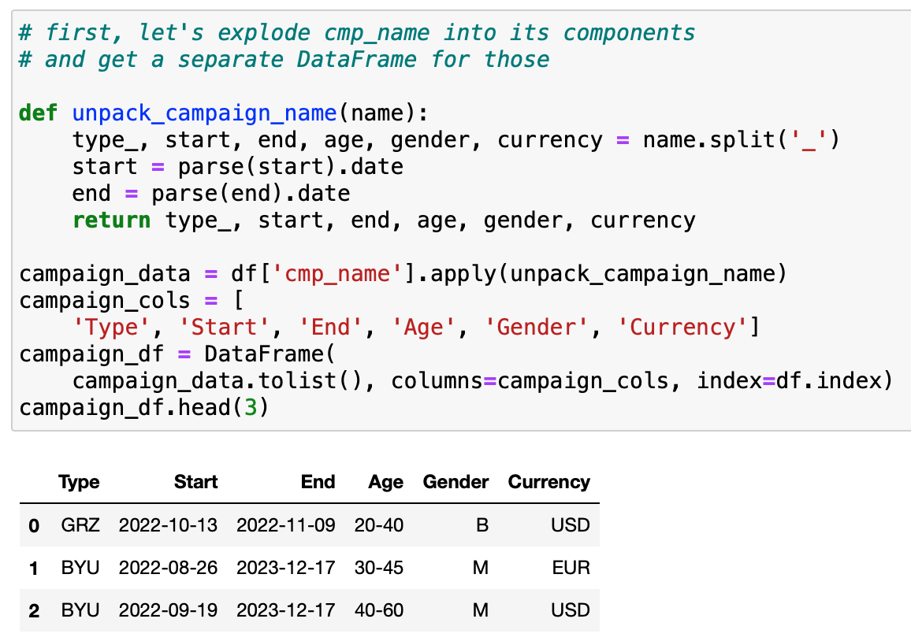
Manipulating the DataFrame
Samantha Liu
Exploding Pandas DataFrame
“Exploding a DataFrame” means splitting a column’s string up using delimiters
The column “cmp_name” is being split up by the character ‘_’ into a separate DataFrame
The negative duration bug occurs here (more info during Any Bugs? section)
Updated code could look like this:
“campaign_data” is created by applying unpack_campaign_name to df[‘cmp_name’]
“campaign_df” is created by converting “campaign_data” to a list + new column names

Slide 5
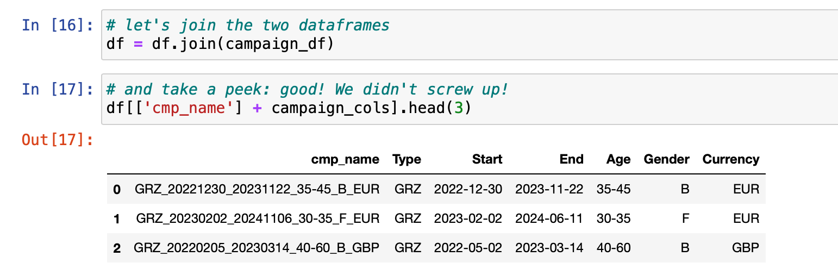
Manipulating the DataFrame
Patrick Casimir
df.join allows us to join the columns of a dataframe with another data frame (df and campaign_df)
.head calls for the first few rows of the table set/dataframe, in this instance the first three rows, starting with an index of 0
Calls for the specific column named “cmp_name” to join the columns affiliated with “campaign_cols”.

Slide 6
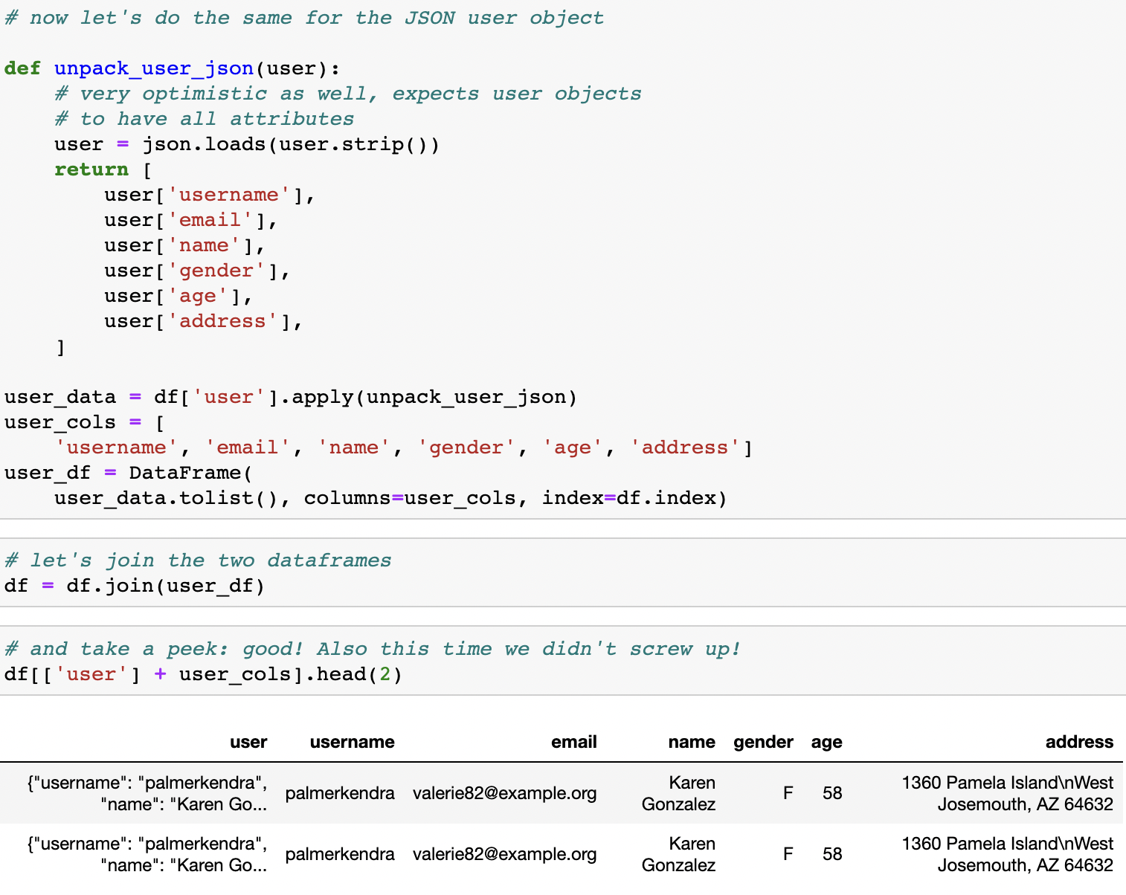
Manipulating the DataFrame
Iqra Malik
Loading the file object, returning a JSON object. This convert the data into a dictionary.
The strip() function removes whitespaces in the beginning and end of the string
Now we apply the unpack_user_json function to the user dataframe, with the respective columns
df.join combines “df” and “user_df”
.head() function helps us view our results. Here, the function is calling on specific columns to join the user dataframe

Slide 7
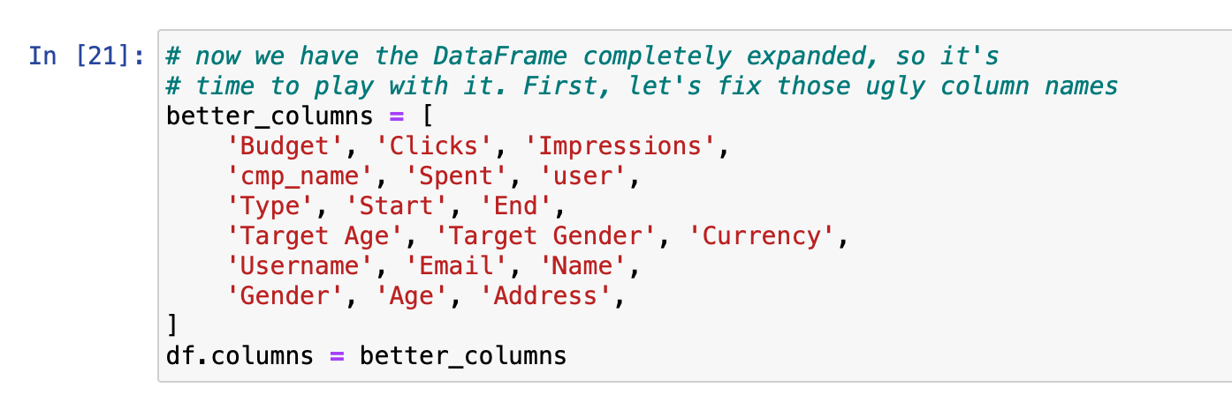
Manipulating the DataFrame
Shota Maehara
we manipulate the DataFrame in order to organize the data. If column names does not make sense, there is no point to manipulate.
Changing name also helps the person who write the code not to confuse.

Slide 8
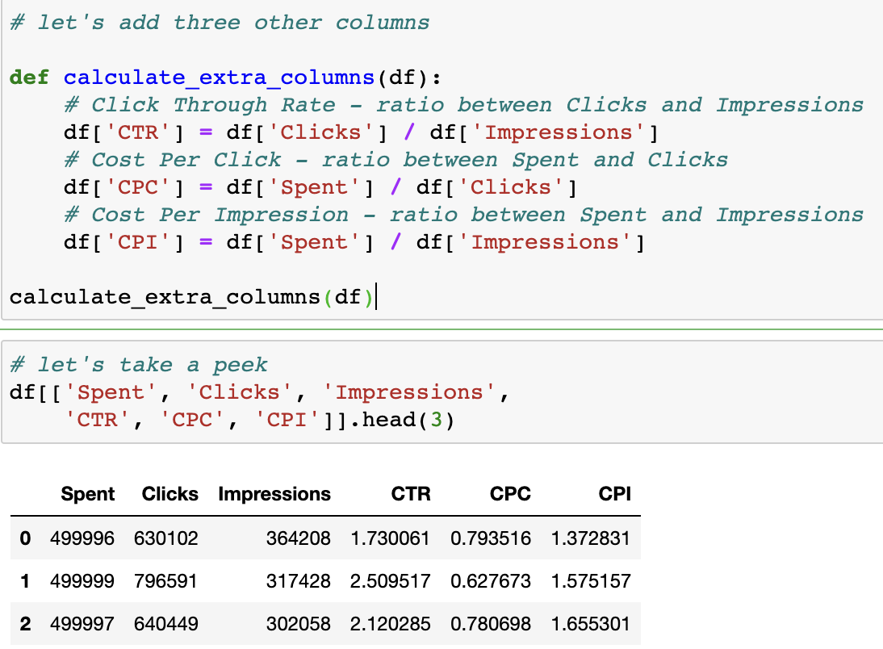
Manipulating the DataFrame
Melisa Ko
The function takes a DataFrame and works directly on it
The DataFrame performs the division from the respective columns for each row
Call the function
Filter the columns and call head to display the first 3 rows
Output shows us the correct calculations for each row
The higher the CTR, the more effective the ad attracts users to click on it

Slide 9
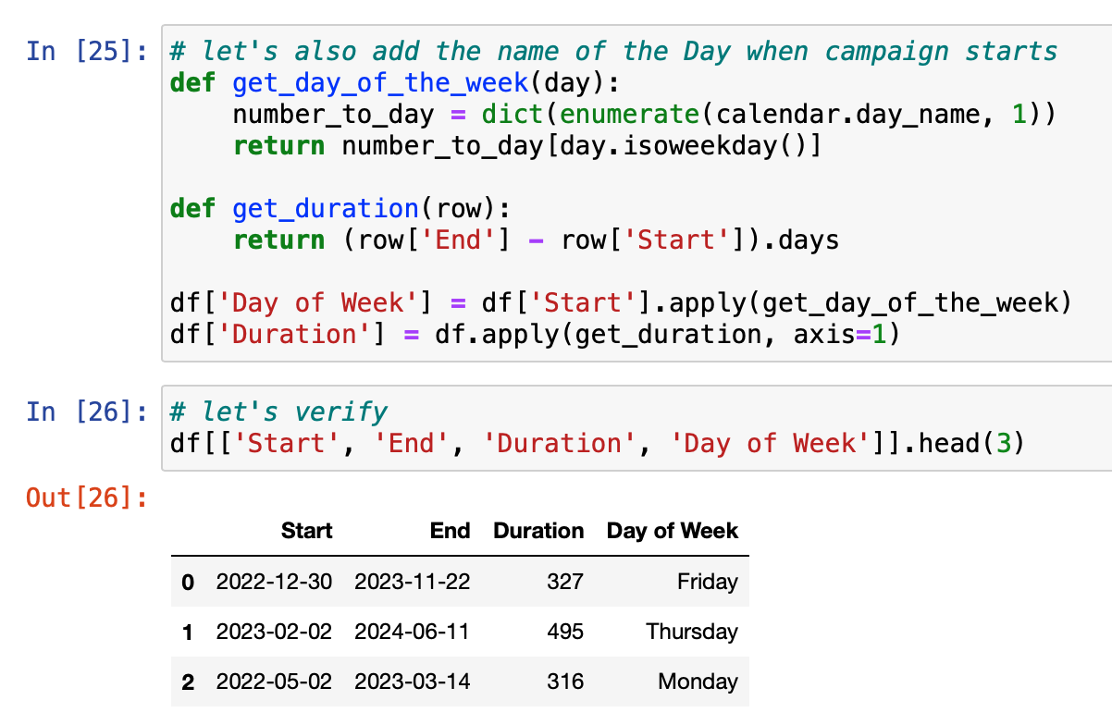
Manipulating the DataFrame
Yasser Khedr
To manipulate the name of the day when campaign starts
we created a function called get day of the week in pandas data frame
where number to day as a enumerate function when we need with count of iteration
That build in function enumerate converts a data collection object into an enumerate object making object items easier to access
And here is the function duration where it gets the time span where it includes start date subtracted from end date to display the duration
And finally to display the data frame which include the function get day of the week with apply.method which allows to apply a function along one of the axis of the data frame with always default 0
And data frame to display the duration function with same apply method with calling function duration with row 1
Finally to display our created function in an order as start, end duration , and day of the week with displaying only the first 3 rows

Slide 10
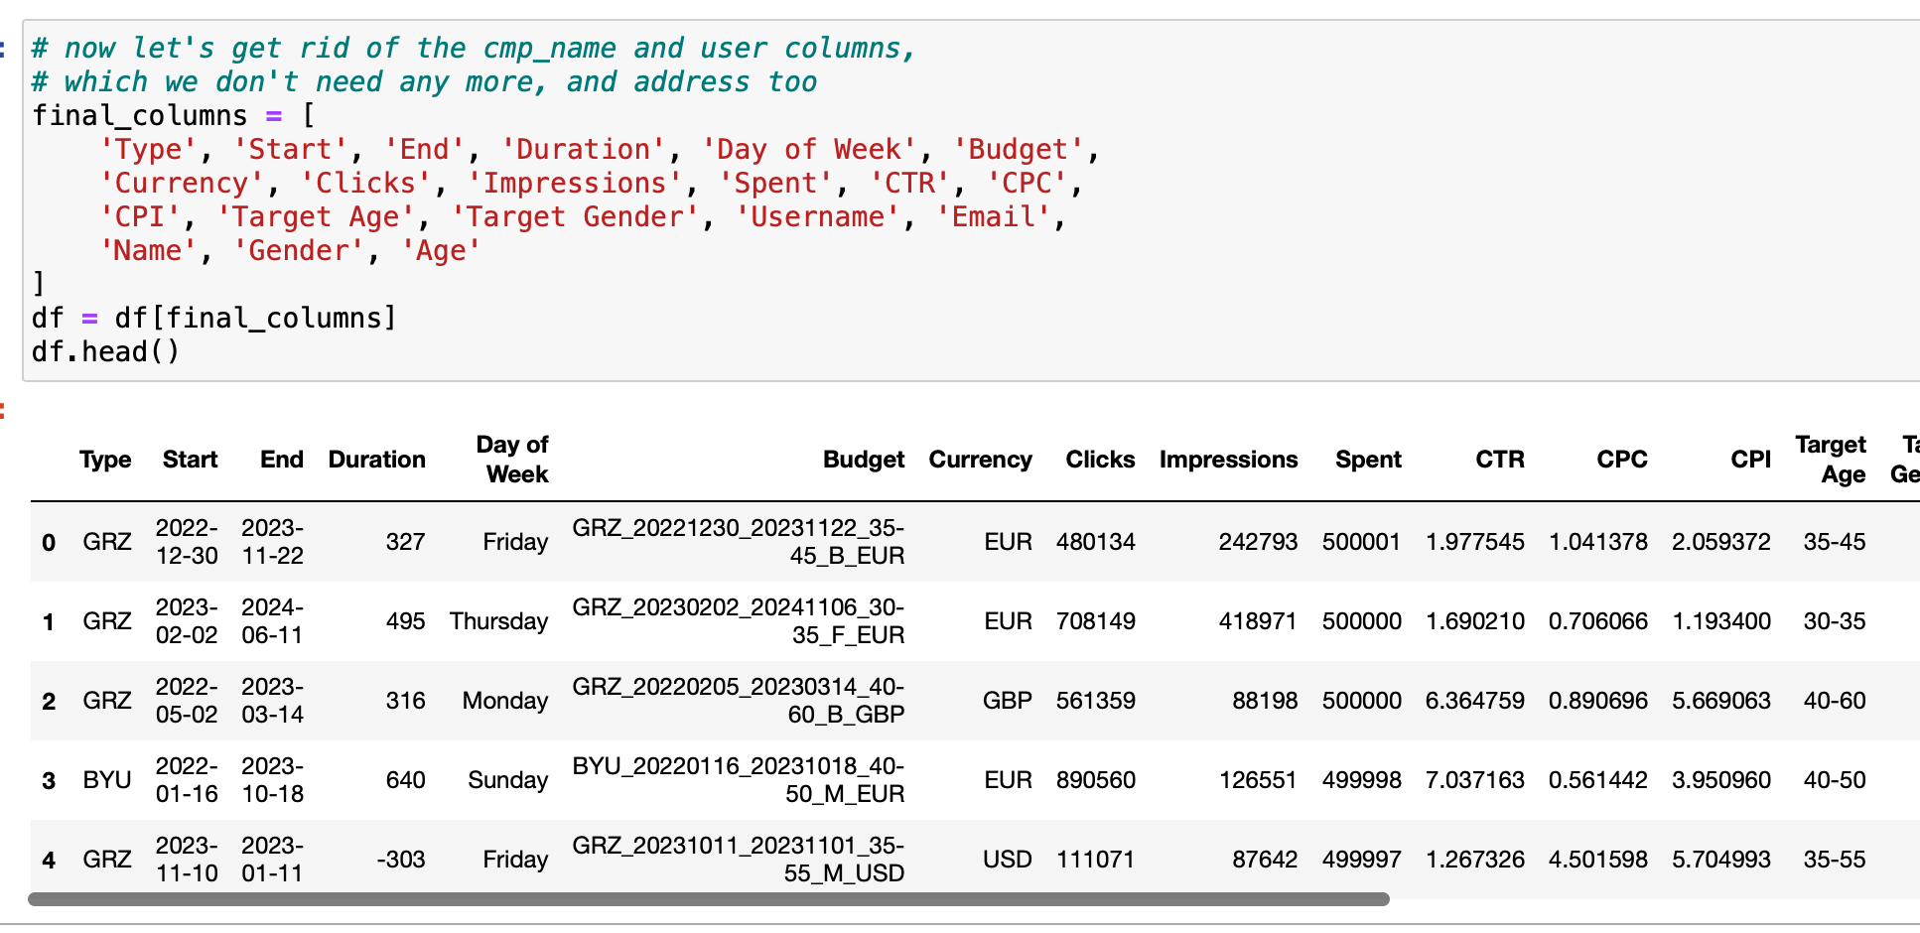
Manipulating the DataFrame
Andrew Zhong
We made “final_colums” as an array of all the columns we want to use.
Then we made the array into a dataframe
Then used .head to print out the first 5 rows of data from dataframe

Slide 11
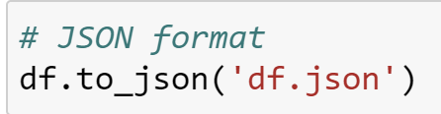
Saving the Data (JSON)
Amin Ahmed
The pandas Dataframe is saved to a JSON format through the method .to_json
This method saves the Dataframe in a JSON string format
The JSON file is saved in the directory where your notebook is in

Slide 12
E X P L A I N

Slide 13
Why Do We Manipulate DataFrames?
Mahfuzul Hoque
Filter out irrelevant or incorrect data
Sort data to make it easier to analyze
Transform data to a different format or structure
Aggregate data to summarize or extract useful information
Join or merge data from multiple sources

Slide 14

Why Should We Save as JSON?
Shameea Mahbub
Compact and lightweight
less processing time (faster accessibility) and memory optimization
Human readability (text-based format)
Easy for machines to parse and generate
Makes it easy to share across platforms & different Operating Systems
Different programming languages

Slide 15
A N Y B U G S ?

Slide 16
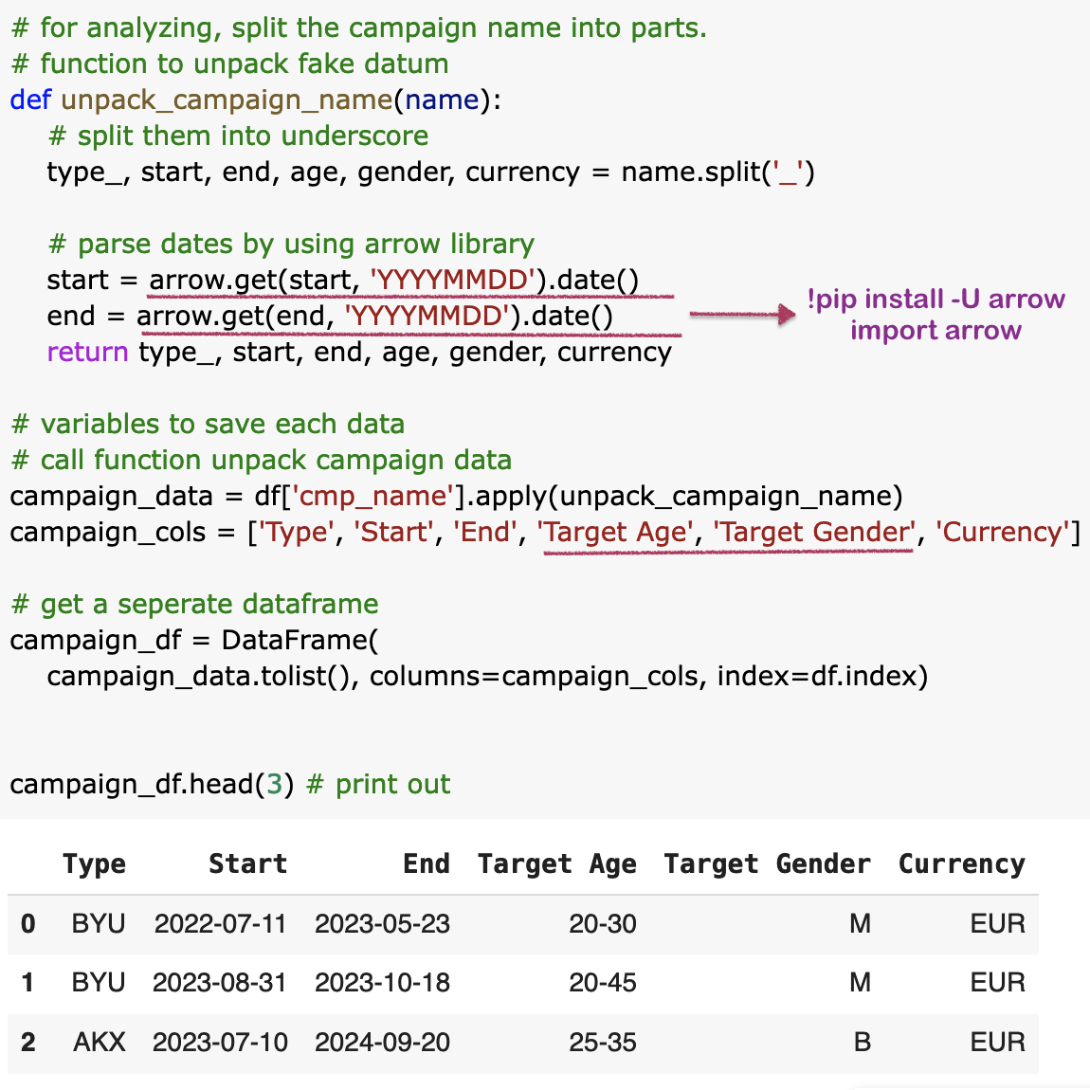
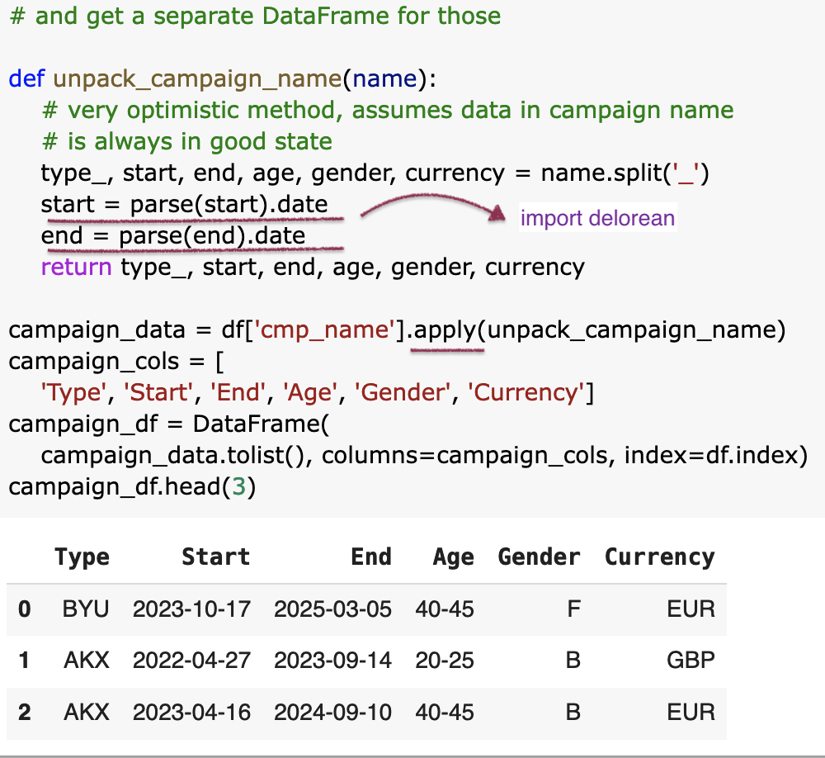
Bug fixing
Yeseo Kim
NameError ~ negative duration bug
A)original code using parse() from delorean
B) alternative code using arrow() from arrow

Slide 17
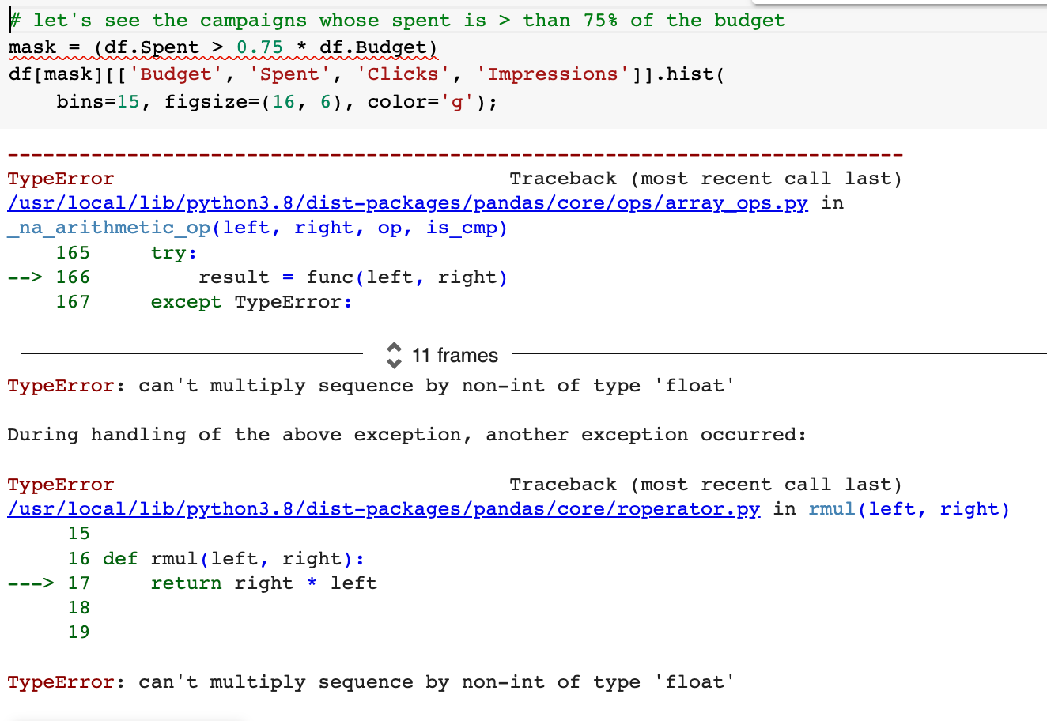
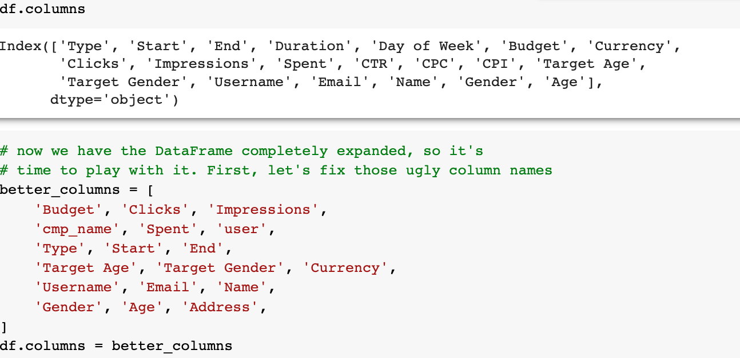
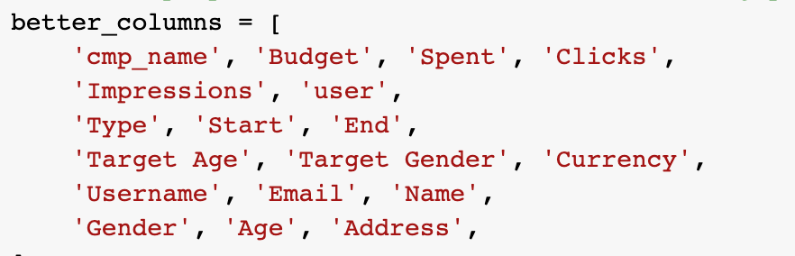
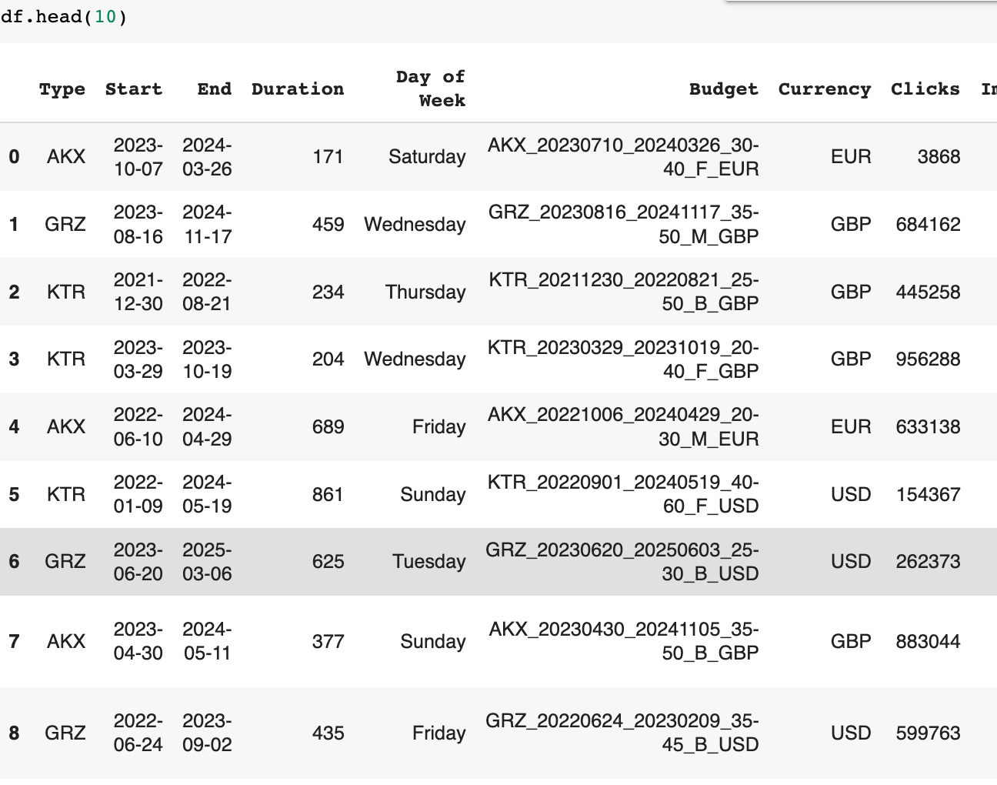
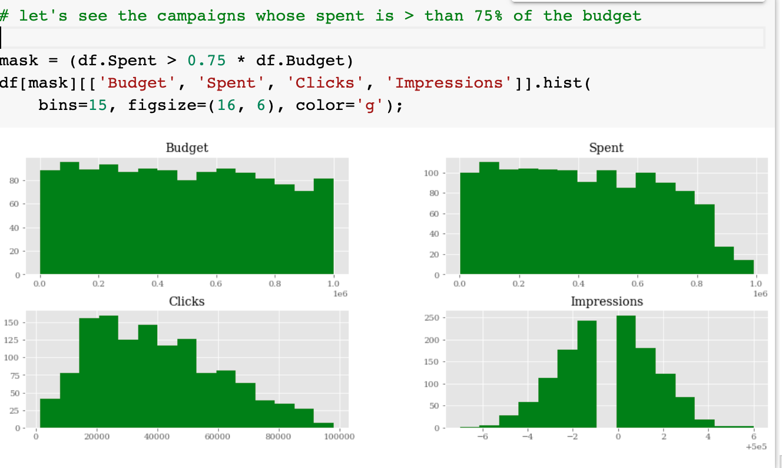
TypeError
Karen Guanga
Original code
Alternative code fixing name placements
Budget is not a float because it was combined with ‘cmp_name’ and was classified as an object, therefore it was not able to multiple with 0.75 (float)

Slide 18
I M P R O V E

Slide 19
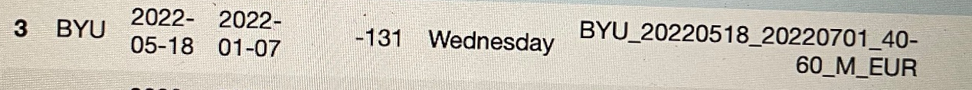
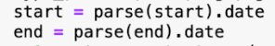
Improve
Timothy Yan
The bug above originated here in slide 4. Since there was no specific instructions for parsing, Python would often mix the date and month.
As seen above, the date and time was supposed to be written in YMD format (2022-07-01) but the output came up as YDM (2022-01-07) instead.
So how can we improve the DataFrame?
We can improve the DataFrame by fixing the bug present in slide 4, by adding specific instructions to the parsing to specify the order of year and date when returning the function.
Remove the Day of Week column (as seen in slide 9 & 10) as it is relatively unhelpful information. It also did not specify the date that was being looked at, as in many examples there were start and end dates present.
Notes:
Some of the things that we can look to improve are the bugs such as those present from slide 4. The parsing start and end bug was essentially a bug that showed the improper format of Y-D-M instead of Y-M-D as originally anticipated. The reason this bug came up is because there were no specific instructions for how Python would organize the parsing structure, so the data from the date and month was often mixed up. So how can we improve this DataFrame? One thing that we can look to improve in the DataFrame is by fixing this bug. This can be addressed by adding specific instructions to the parsing to specify the order of year and date when returning the function. Another thing that could be improved is by removing the Day of Week column from slide 9 & 10 which has been shown to be relatively trivial information. It doesn’t specify which date was being looked at so it was often unclear if it was referring to the start date or the ending date. However upon further inspection, we found that it only marked the start date in the data set, not the end date which we confirmed by manually checking the date. Following me will be Jeongwon who will be doing the conclusion.

Slide 20
Conclusion
Jeongwon An
Present
Manipulating Dataframe
Explain
two questions
Fix bugs
Improve
Dataframe

Slide 21
THANK
YOU!
CIS 3120 - Groups 8, 9, 10

